Slide 1
College to Post-Grad
Team 2: Easing Life Transitions

Slide 2
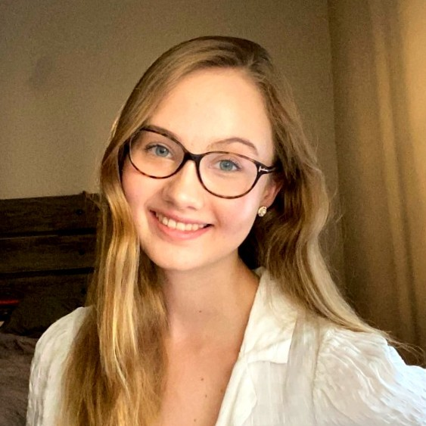
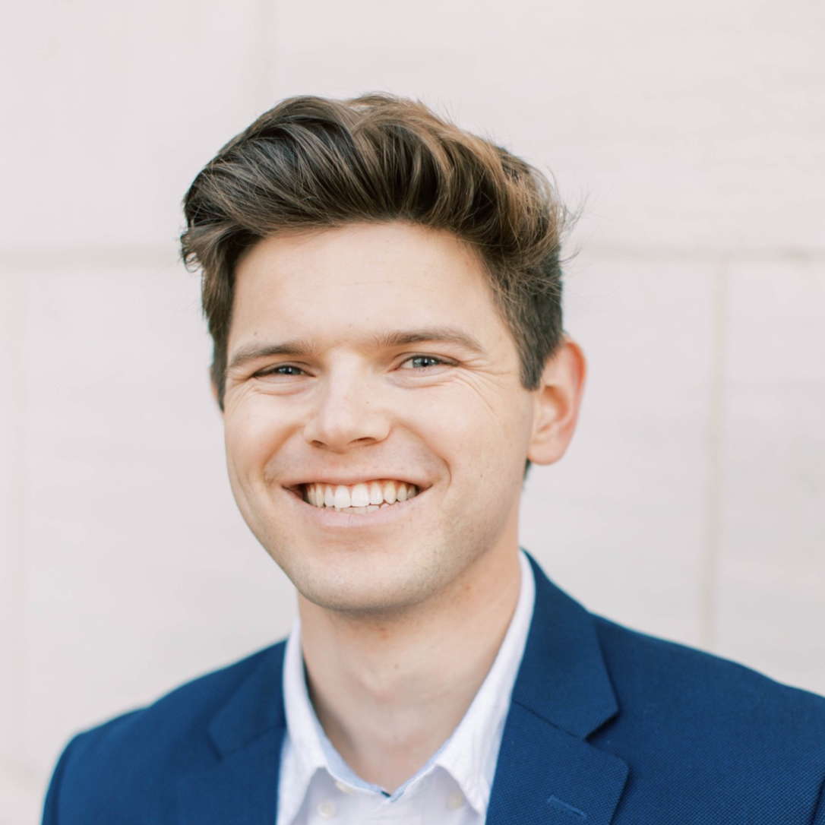
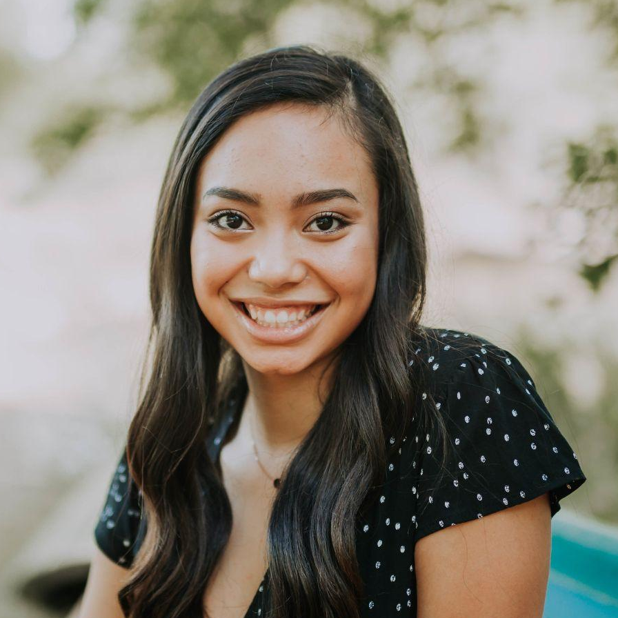
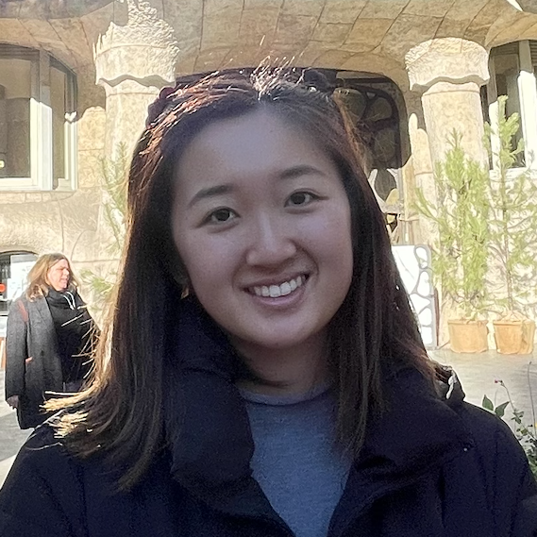
Our Team
Amelia
Chris
Jasmine
Tiff
Senior
Math & CS
Junior
SymSys
Senior
MS&E & CS
Senior
SymSys & English

Slide 3
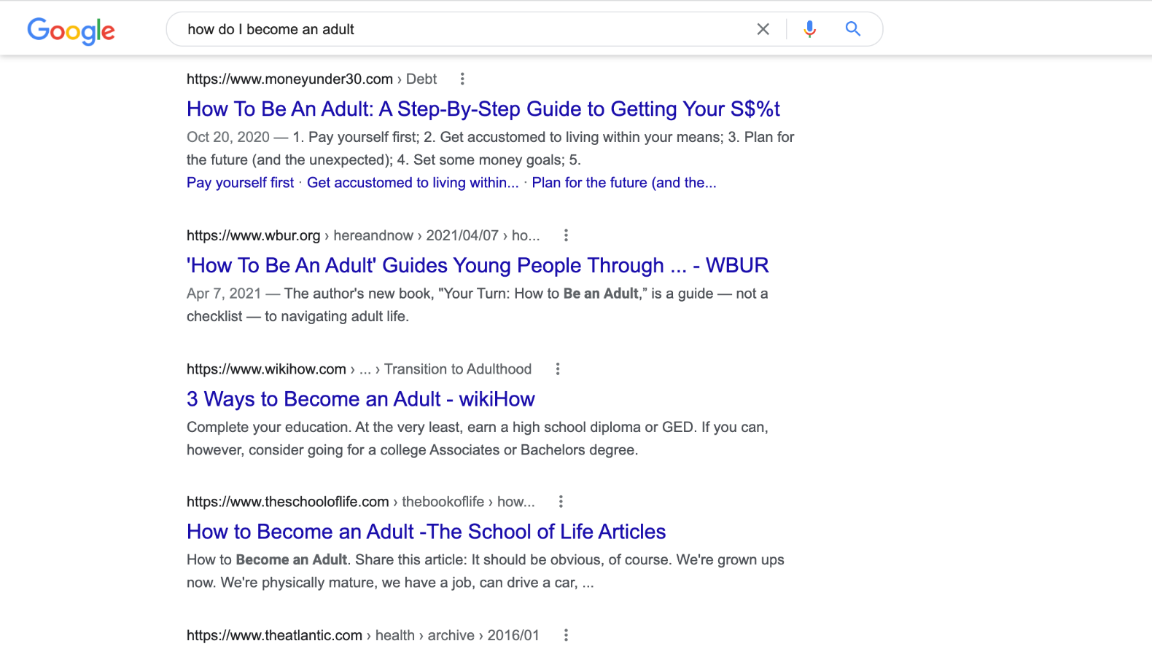
Problem Domain
Transitioning out of college to being a “real adult”
Notes:
College -> post-grad “real adult”
But none of us have gone through this transition yet…so we talked to various people all across this transition

Slide 4
Participant Selection
1
2
3
Transition Stage
Geographic Location
Outside of Stanford “bubble’
Still in college vs. currently transitioning vs. transitioned to post-grad
Different areas of the US, international
Variety of social environments, academic pathways
Areas to improve: diversity in race, type of post-grad career path
Notes:
Recruited participants via friends-of-friends, no compensation, interviewed in pairs over Zoom
Breaking down our participant selection
Transition stage - talked to ppl at various stages in transition
Still in college, currently in the middle of transitioning to post-grad, already established in post-grad
Geographic location - people all across US and even international
Mindful of reaching out beyond Stanford bubble
Occupy diff social environments and went down different academic paths
Areas to improve for future interviews
Diversifying our interviewee pool and interviewing ppl who are in different post-grad career paths - everyone we interviewed is connected to a corporate career path

Slide 5
Our Participants
Amanda
Shivansh
Rachel
Enrique
Yale Student
Switching from academia to tech
New Haven, CT
Recent Duke Grad
International student & Consultant
NC - Belgium – India
NYU Grad
Marketer & Dancer, Graduated in 3 years
New York, NY
ASU Grad
Accountant & Homeowner
Tempe, Arizona
Notes:
Now let’s get to know the specific interviewees!
Amanda: Yale senior living in New Haven, CT, studying physics, always thought she was going to go into academia but recently switched career trajectory to tech/industry
Shivansh: Recent Duke grad and international student who splits his time between NC, Belgium, and India and is about to move into SF, going into consulting job.
Rachel: Recent NYU grad who studied dance, graduated in 3 years, and is now working in marketing in NYC.
Enrique: our extreme user. ASU grad who went on a non-traditional academic pathway through community college and ASU and early graduation. Most shockingly, he is already a homeowner and is currently working on renovations for his house - p unconventional for recent college grad.

Slide 6
Guiding Questions
General
Career
Financial
What is/was top-of-mind for you in the post-college transition?
Can you tell us about how you went about figuring out your post-grad job?
Are there differences in how you handle finances now vs. in college?
Living Situation
Geographical
Social
Tell me about the living situation(s) you’ve encountered since college.
What surprised you about where you live post-college?
Describe a typical hangout with friends now vs. in college.
Notes:
When talking to interviewees, it can be hard to talk abt such a huge transition w so many moving parts. Beyond asking what was top of mind as ppl were making their post-grad transitions…
Broke transition into five subgroups: career, financial, living situation, geographical, social/personal
Probed more about types of living situations you’ve been in post-grad, what surprises u’ve encountered, the process of finding post-grad job

Slide 7
Results

Slide 8
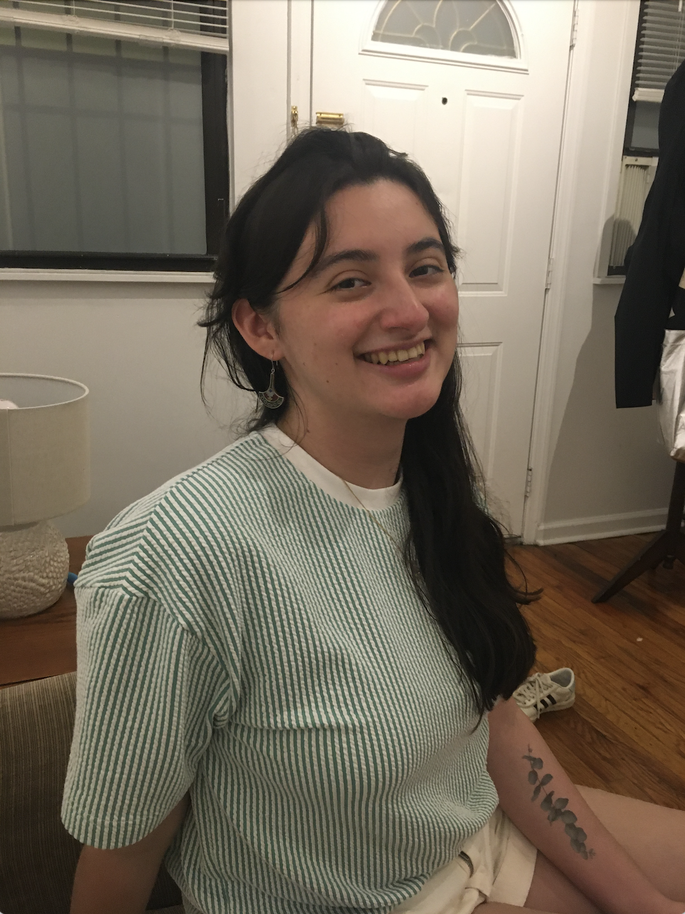
Amanda
Yale Undergraduate Senior, Physics
Zoom (40 min) interview
“I wish I had the opportunity for more general life skills preparation.”
Notes:
“I wish I had the opportunity for more general life skills preparation”

Slide 9
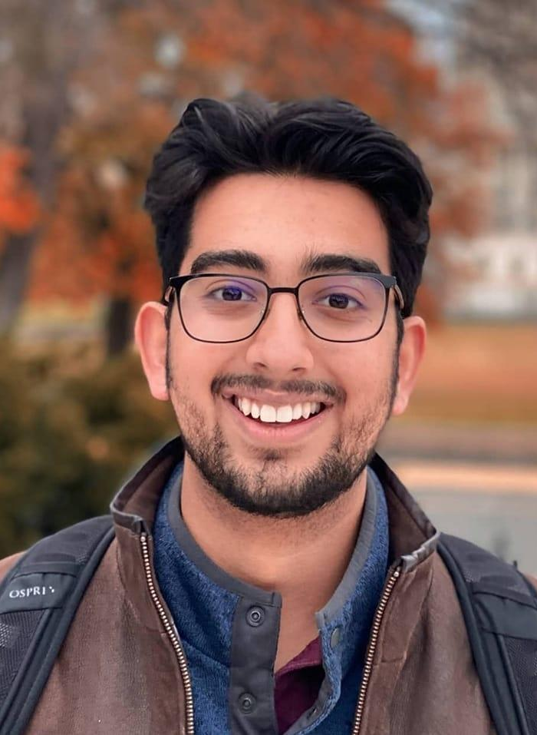
Shivansh
Recent Duke Grad, Consultant, International
Zoom (30 min) interview
“In college, you're subscribing to a community rather than building a community from scratch post-grad.”
Notes:
“In college, you're subscribing to a community rather than building a community from scratch post-grad.”

Slide 10

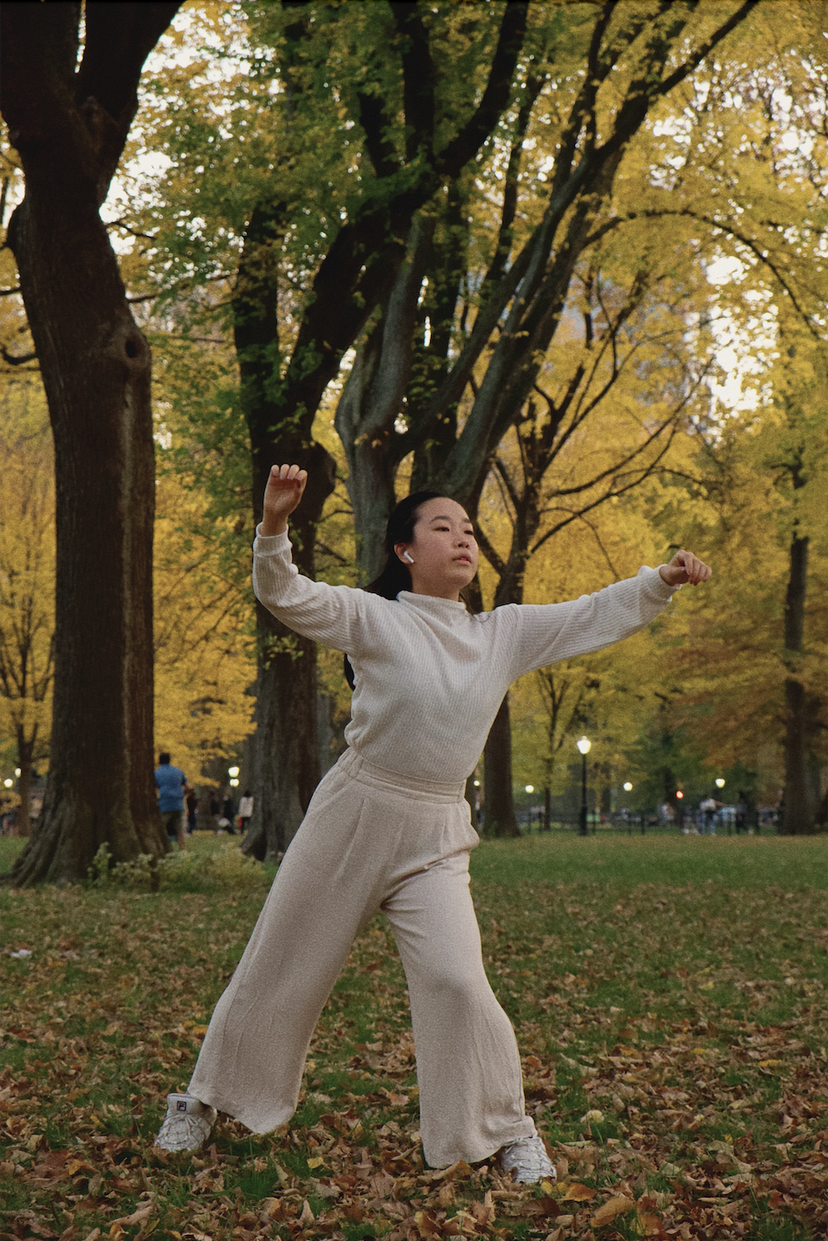
Rachel
NYU Grad, Marketer & Dancer
Zoom (50 min) interview
“It’s hard to realize you’re moving on. Even when you’re not ready, the world is still moving on.”
Notes:
“It’s hard to realize you’re moving on. Even when you’re not ready, the world is still moving on.”

Slide 11
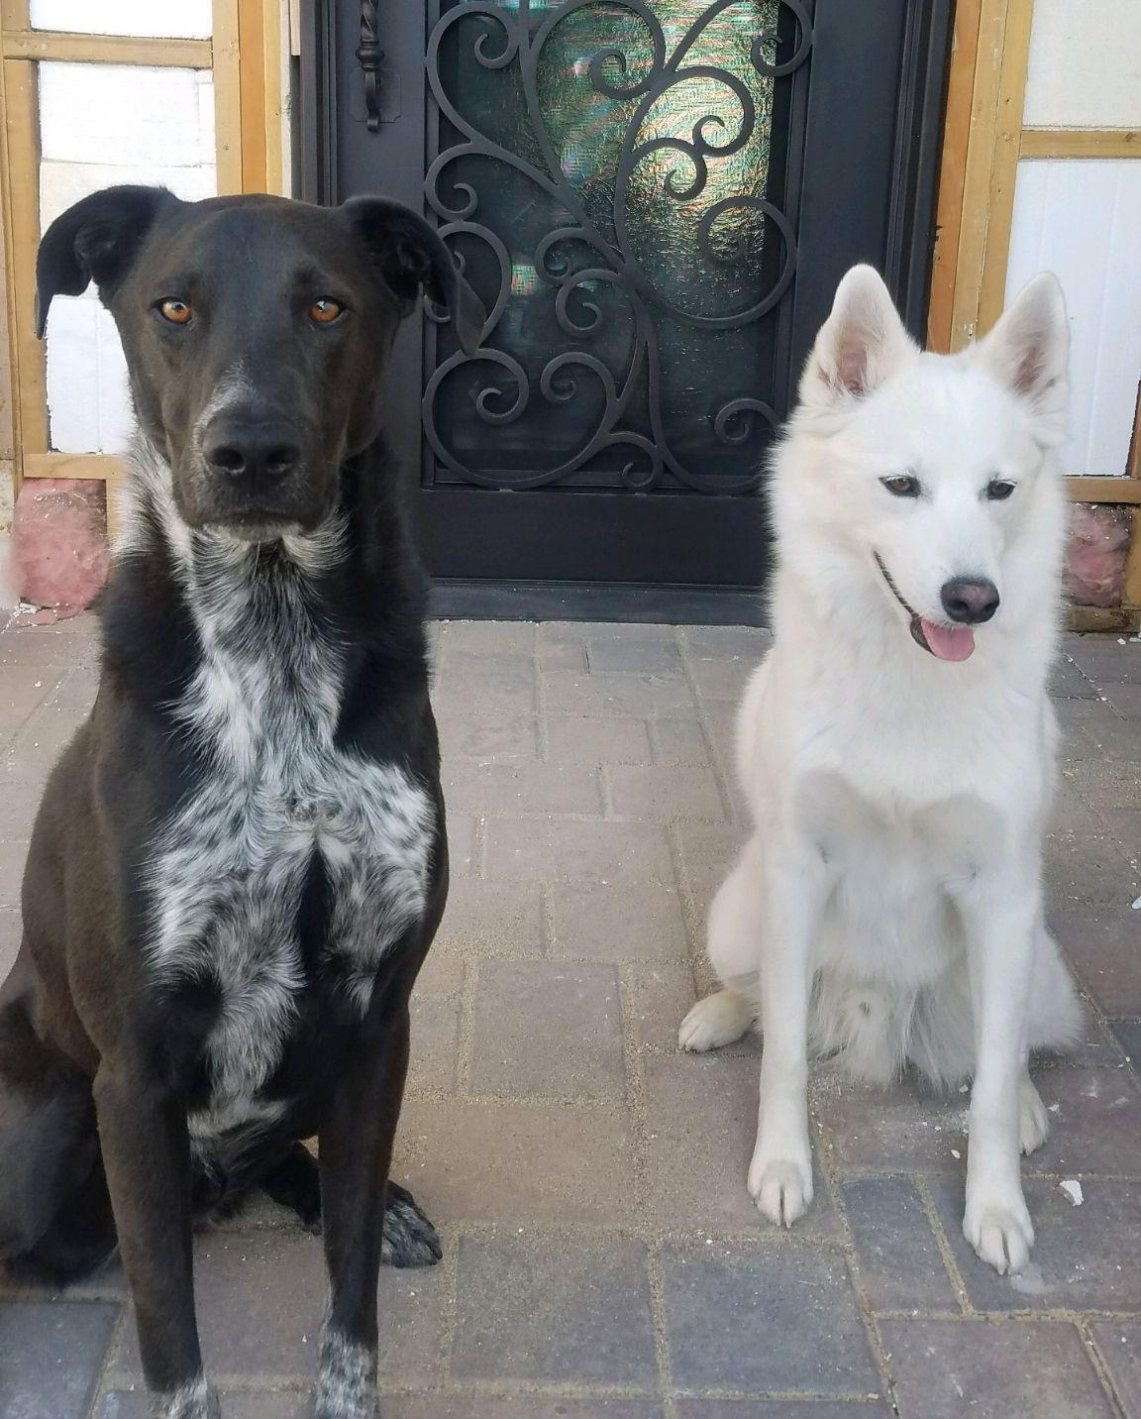
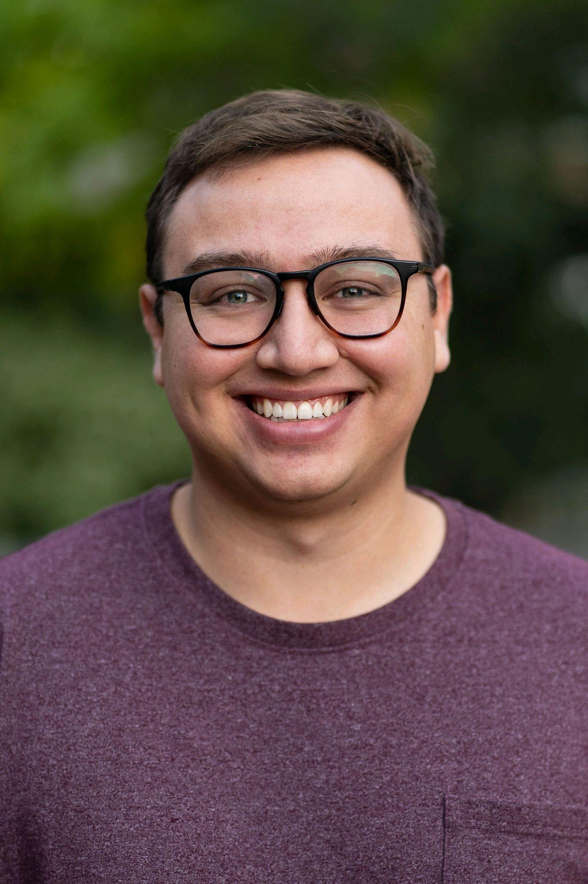
Enrique
ASU Grad, Homeowner & Accountant
Zoom (30 min) interview
“Bigger transition than out of college was from apartment to house.”
Notes:
Extreme user
Homeowner and accountant
“Bigger transition than out of college was from apartment to house.”

Slide 12
Empathy Maps & Key Takeaways

Slide 13
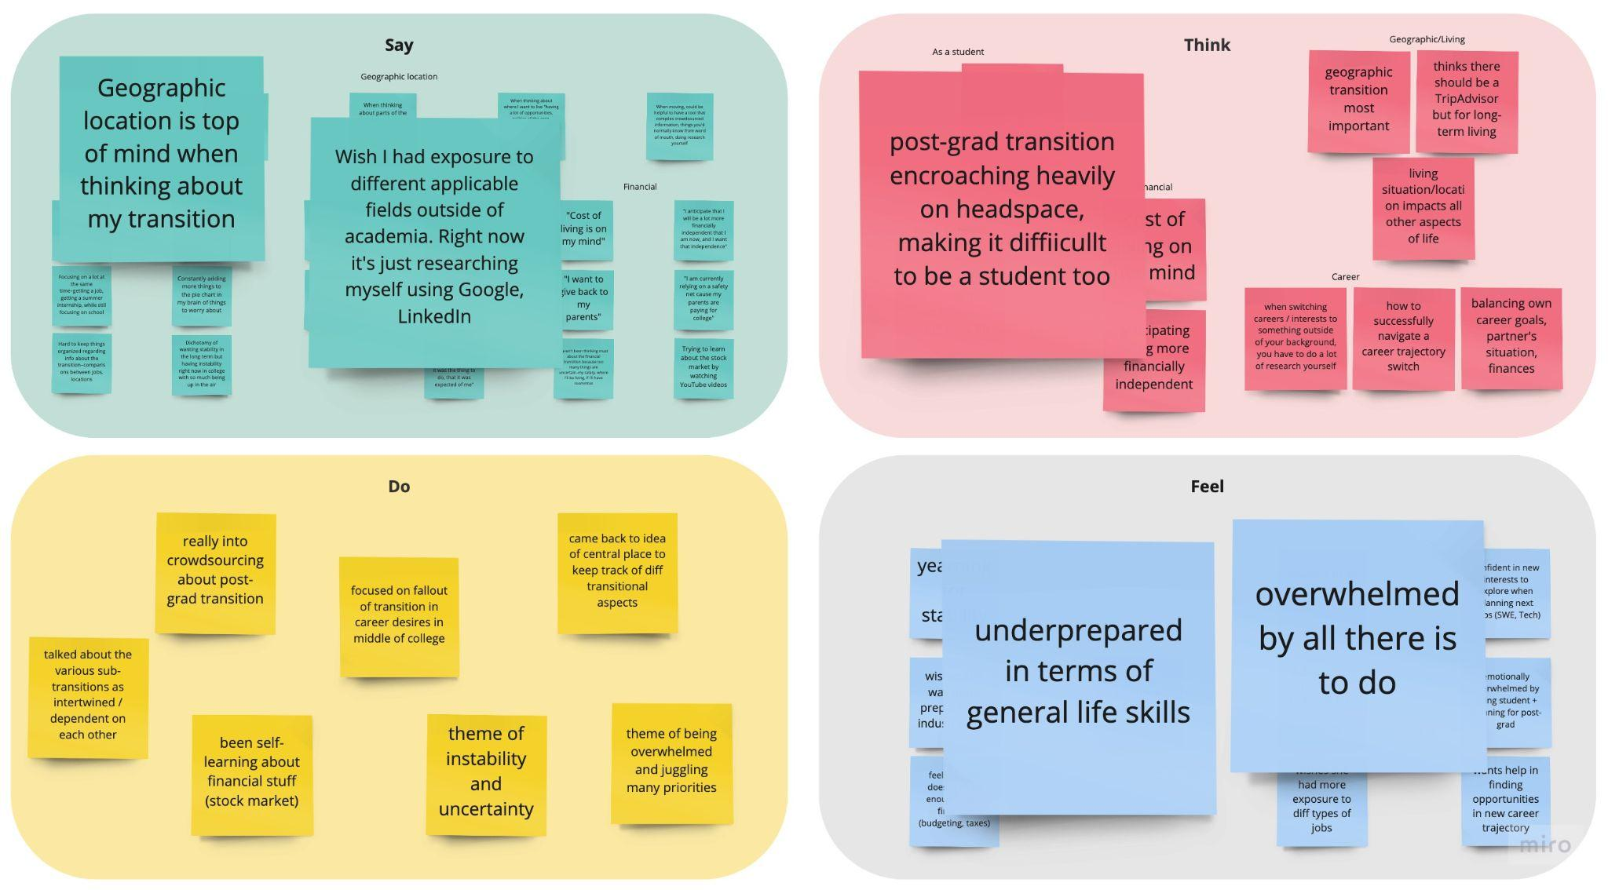
Amanda
Notes:
Most prioritized geographic location bc that determines community
Transitioning from academic path to industry path
Overwhelmed by being student + planning for post-grad
Underprepared in financial skills

Slide 14
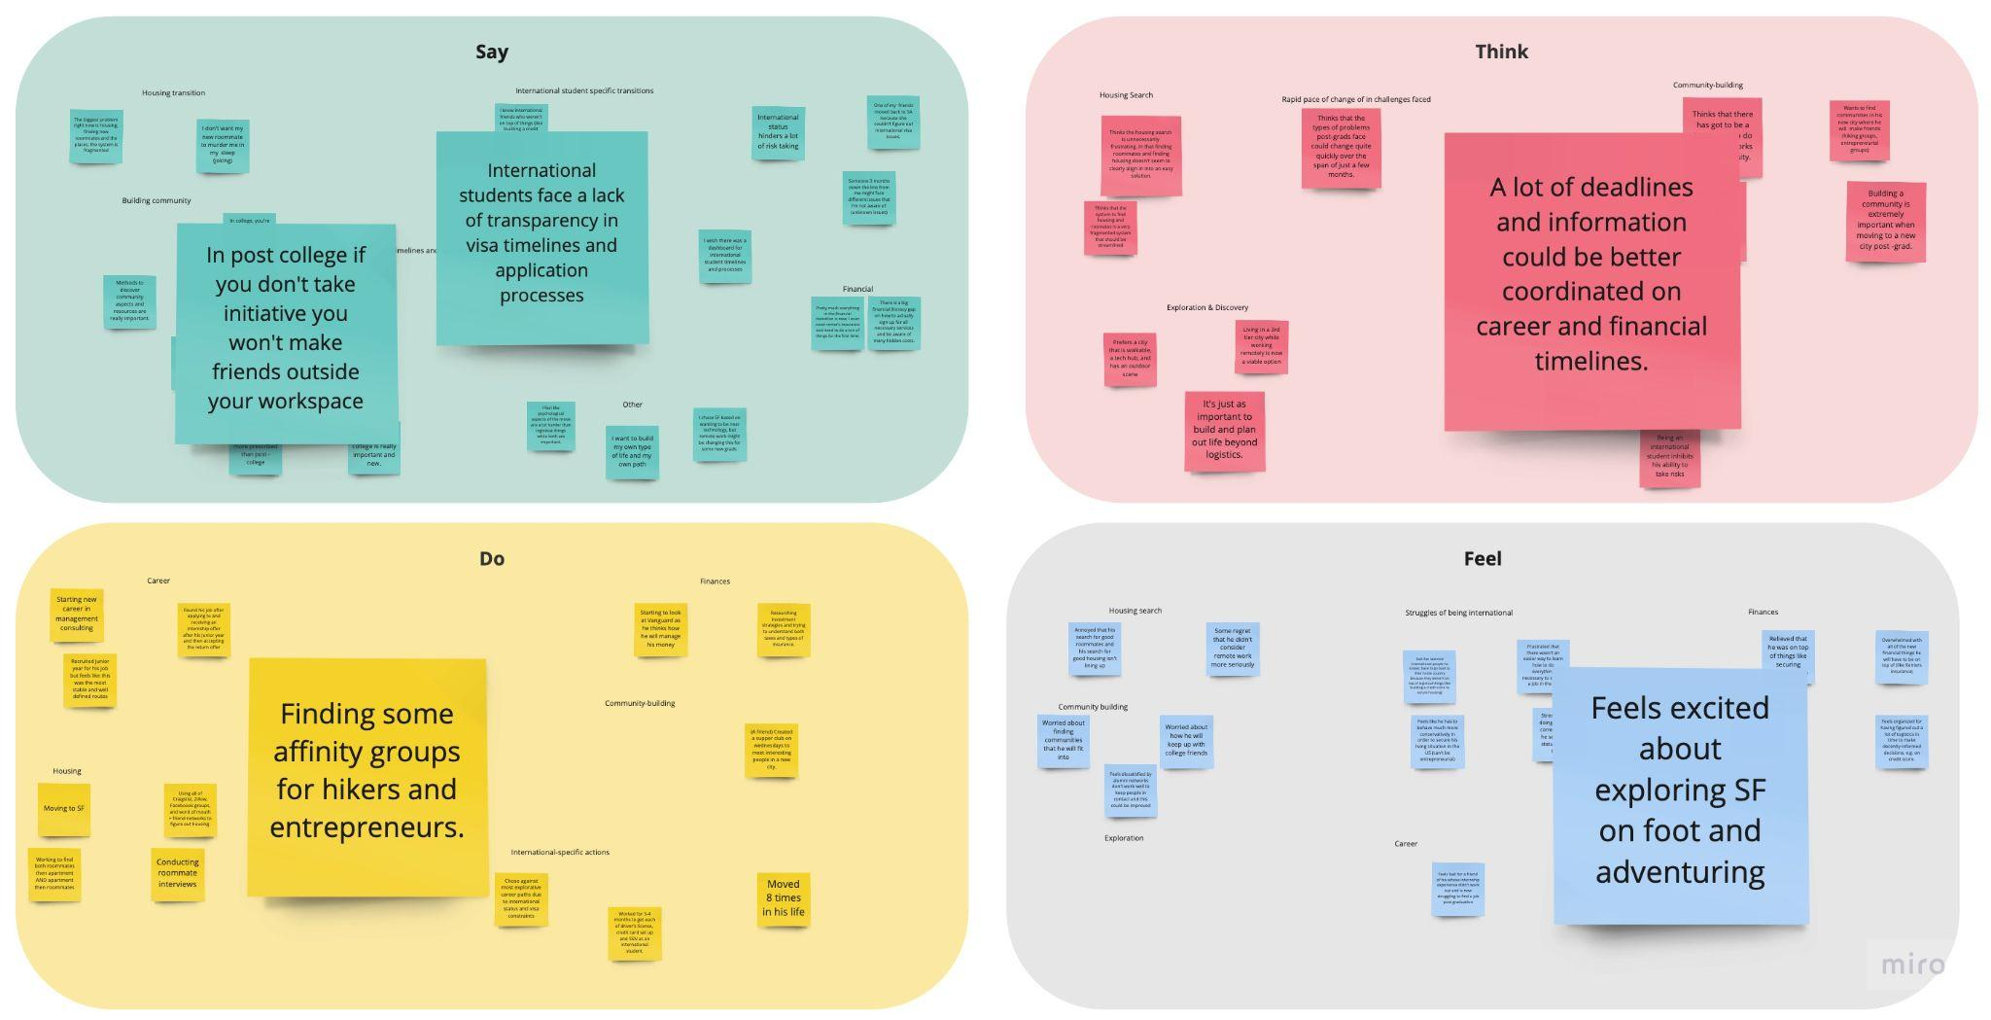
Shivansh
Notes:
Dealing with lots of tasks and hurdles for international students → lack of transparency and hectic deadlines
Excited about exploring new place and building new communities, but conscious of need to take initiative in building post grad community outside of college.

Slide 15
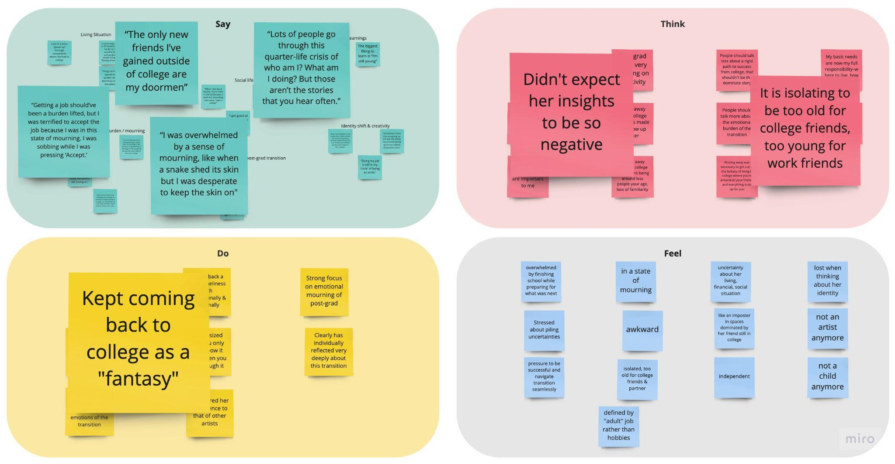
Rachel
Notes:
Already graduated and living alone in NYC
Focused on emotional elements - social isolation and quarter-life crisis
Very struck by two of her quotes about college
Accepting job while sobbing
“I was overwhelmed by a sense of mourning, like when a snake sheds its skin, but I was desperate to keep the skin on”
College = fantasy, post-grad = harsh reality
Surprised by negativity of her experience

Slide 16
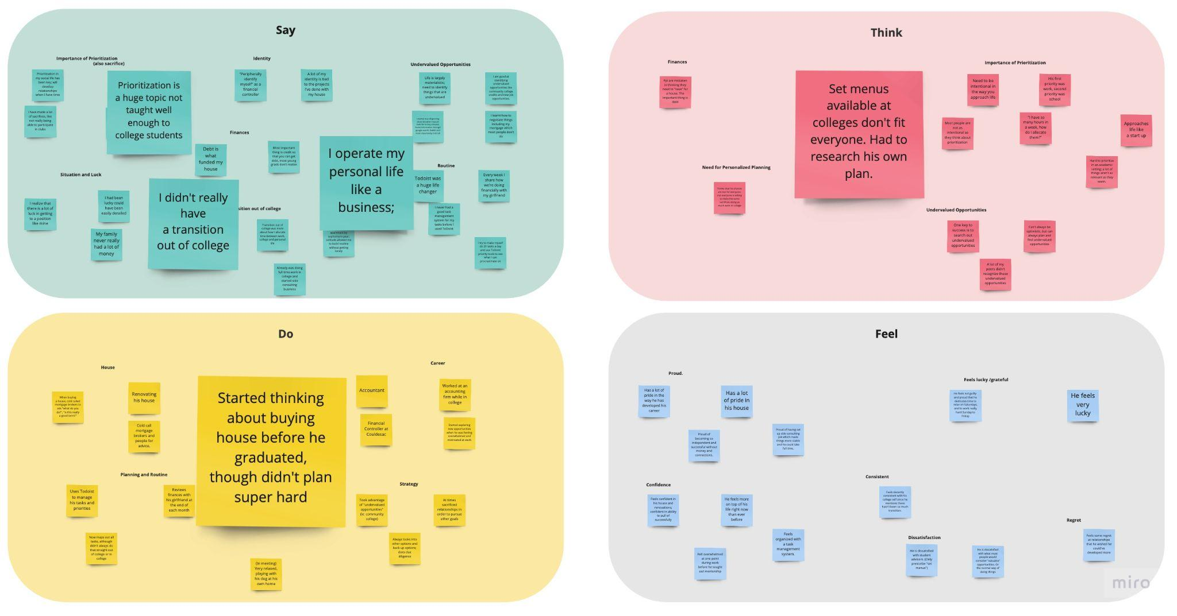
Enrique
Notes:
Prioritization is huge topic and not taught well to college students
Operates personal life like a business - very efficient & focused on productivity
Underwhelmed by resources for post-college - had to forge his own path
College and post-grad blurred together bc he was working during college & already thinking abt buying house

Slide 17
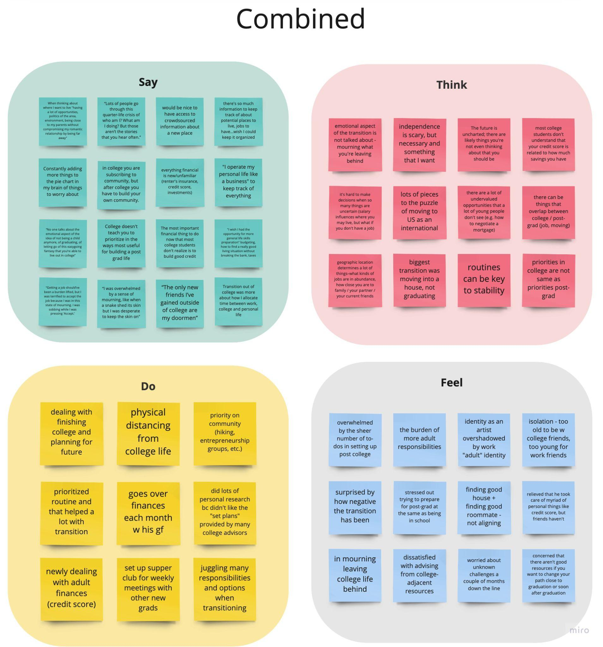
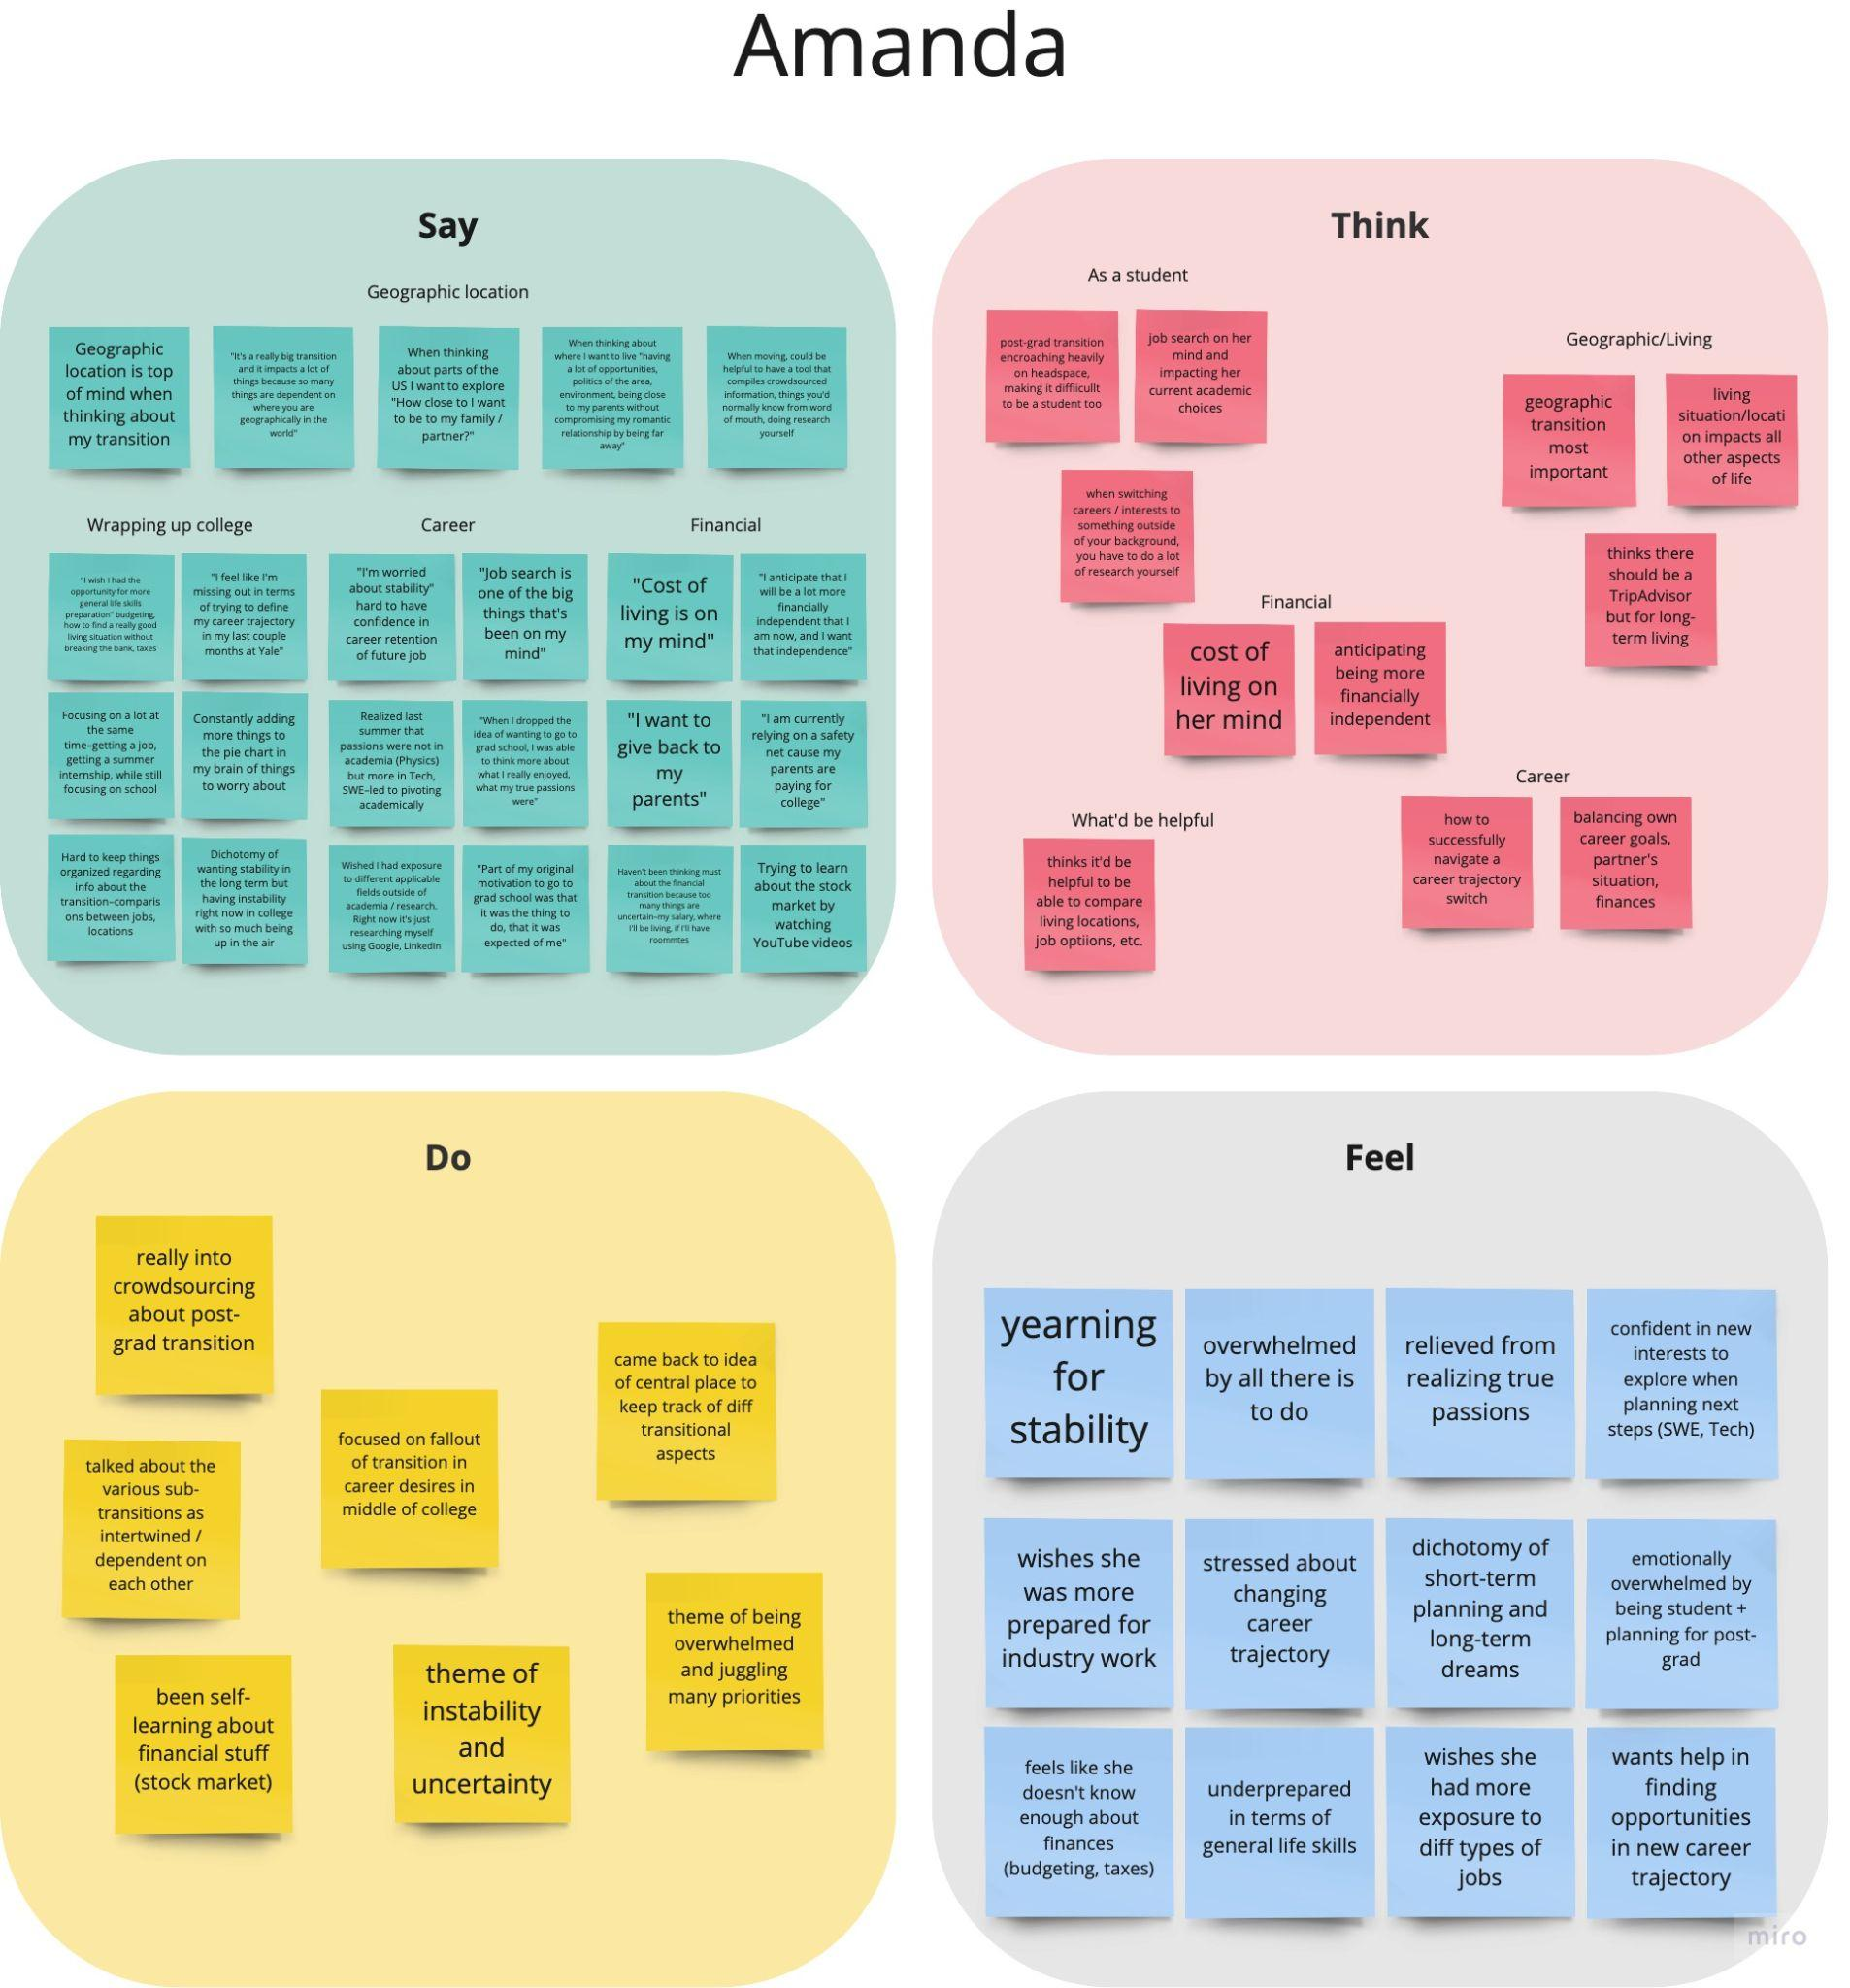
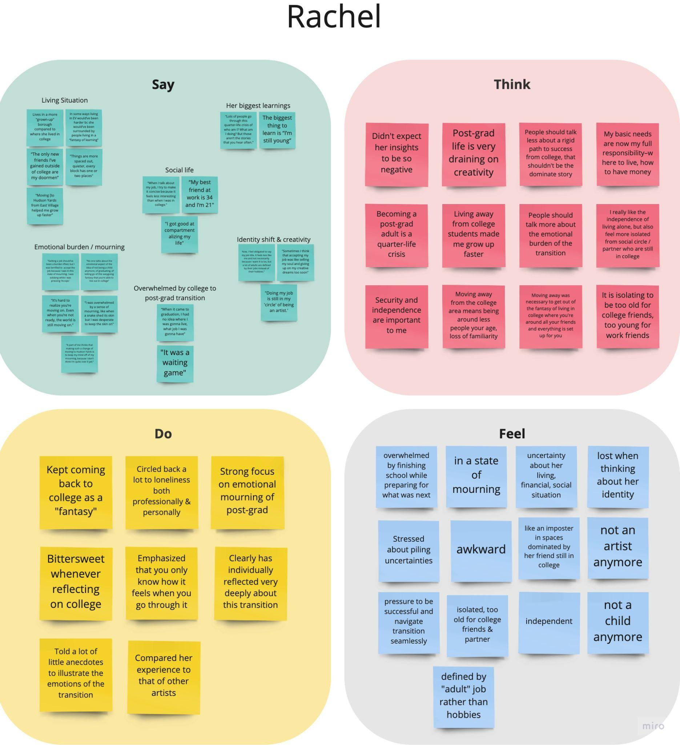
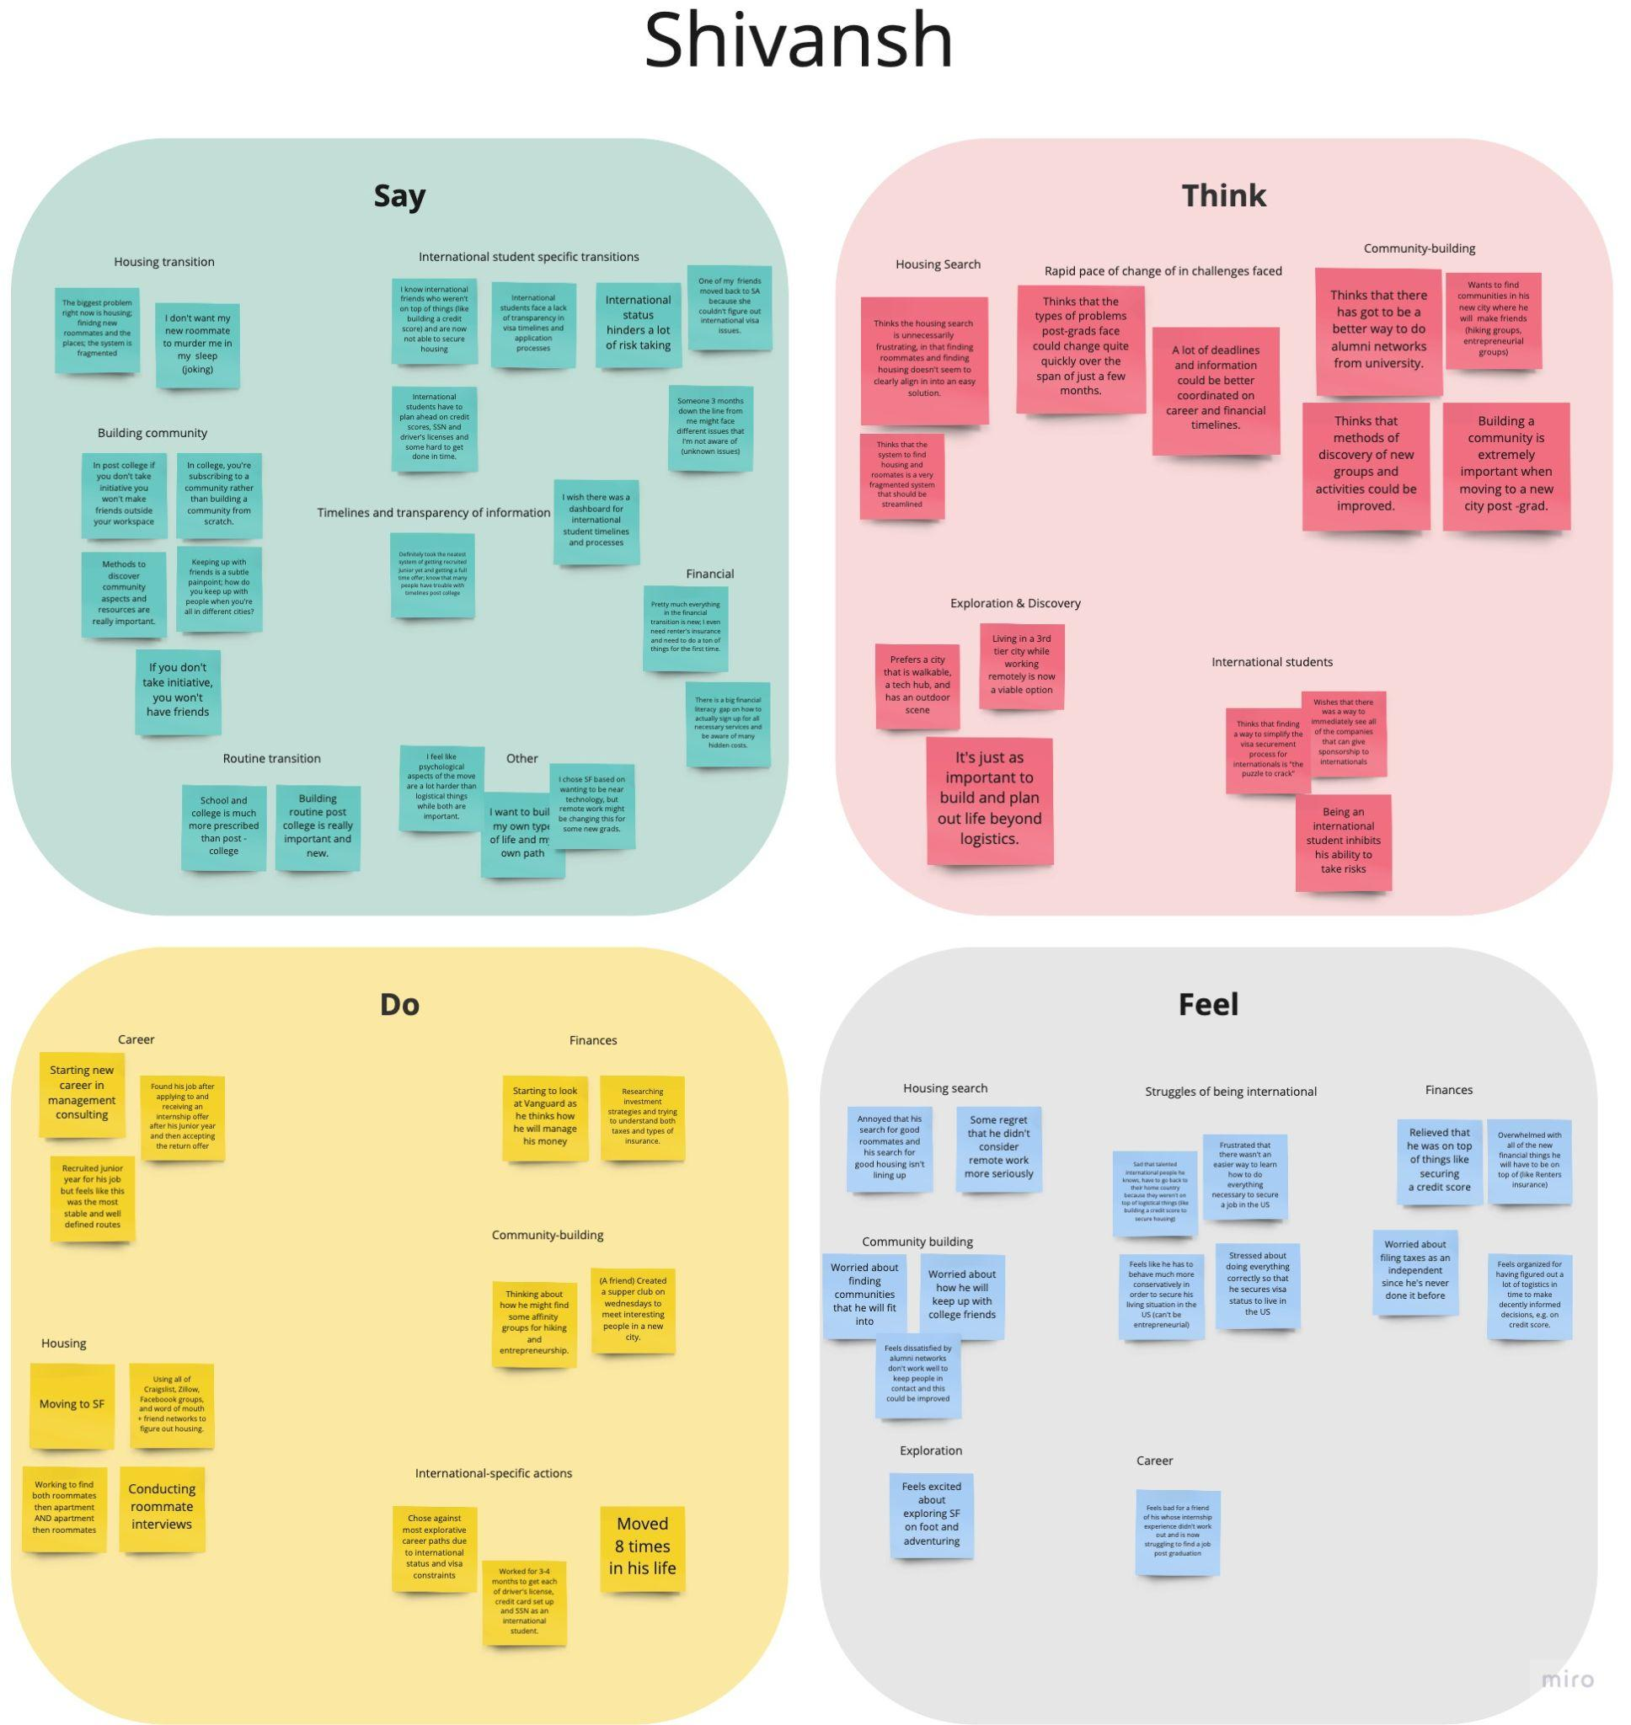
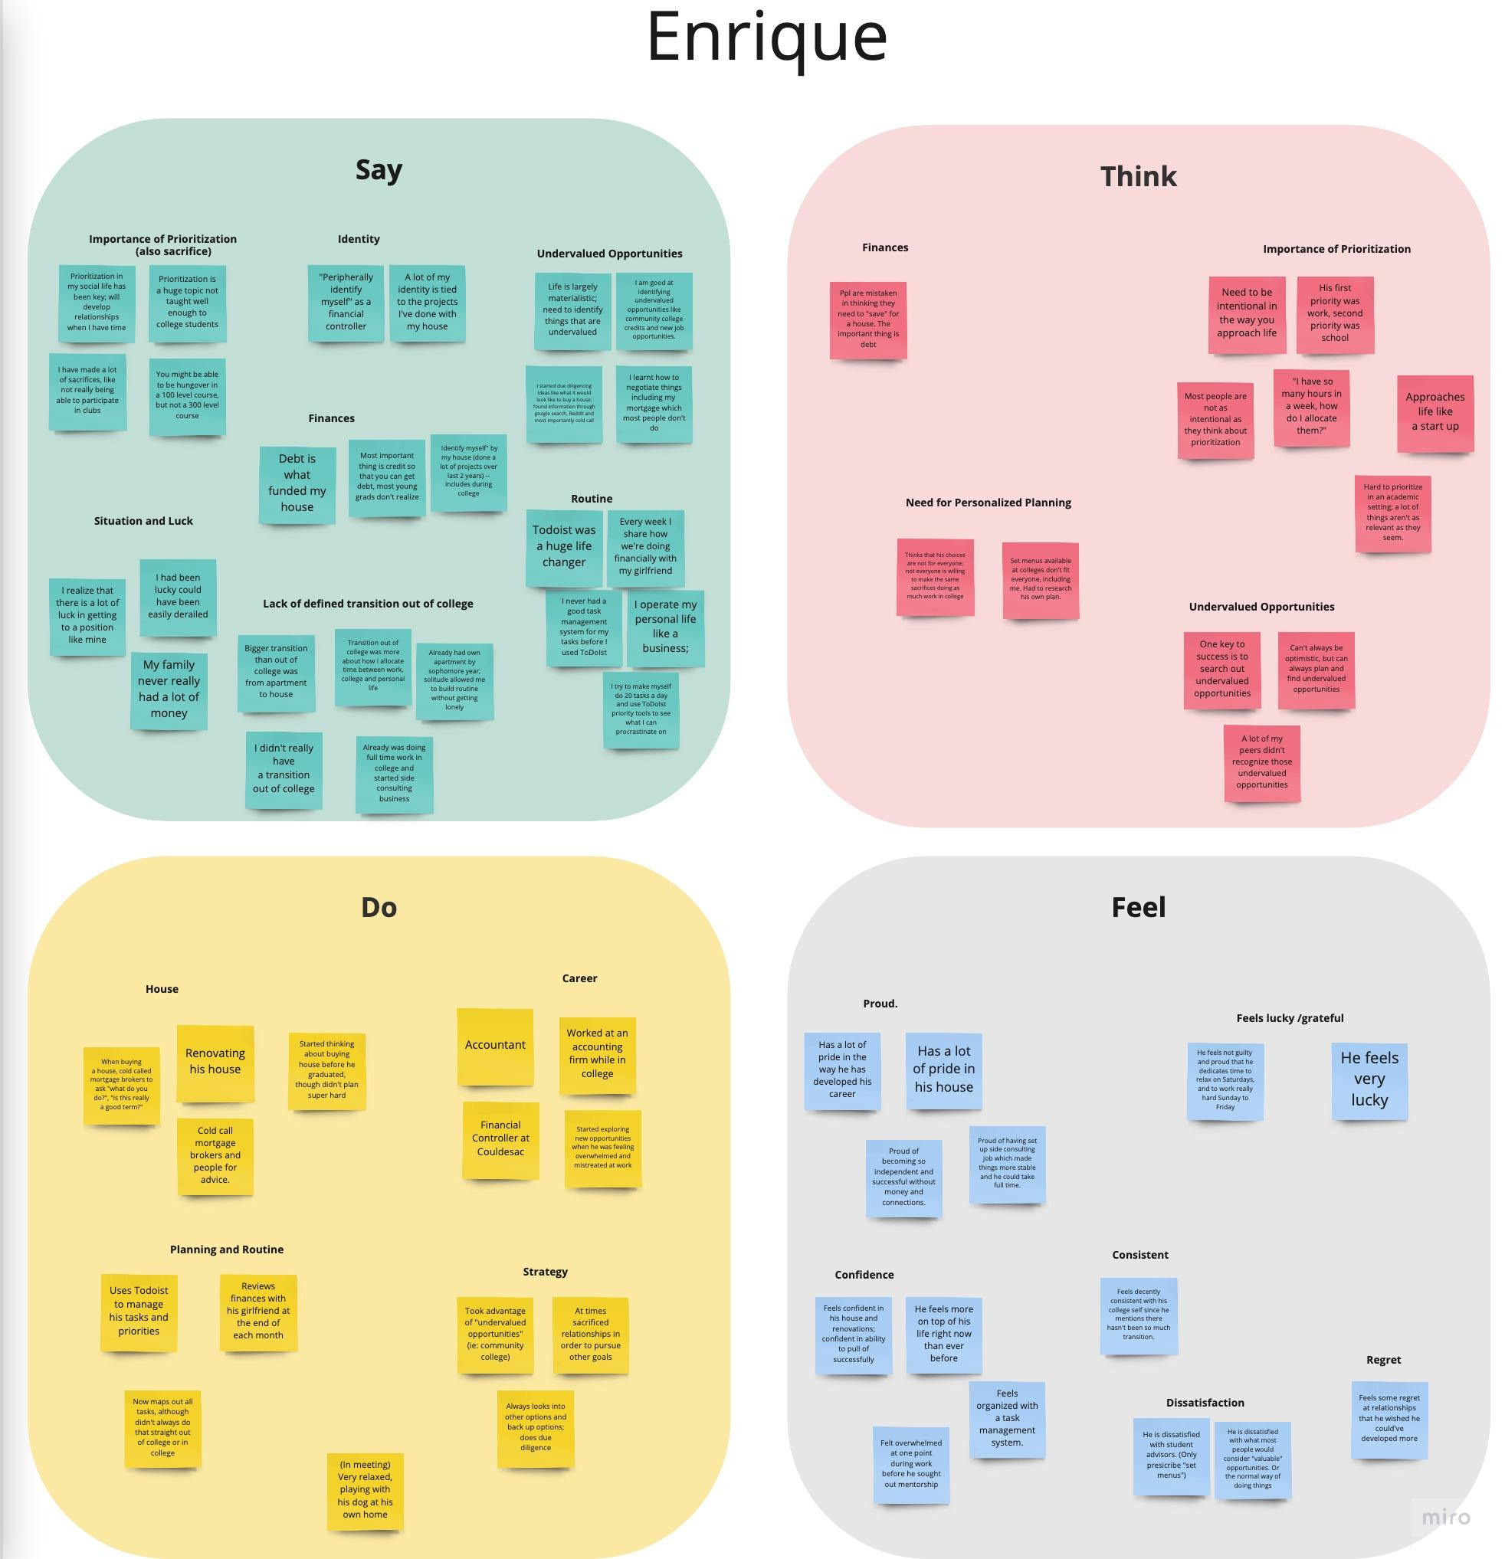
Synthesized Empathy Map

Slide 18
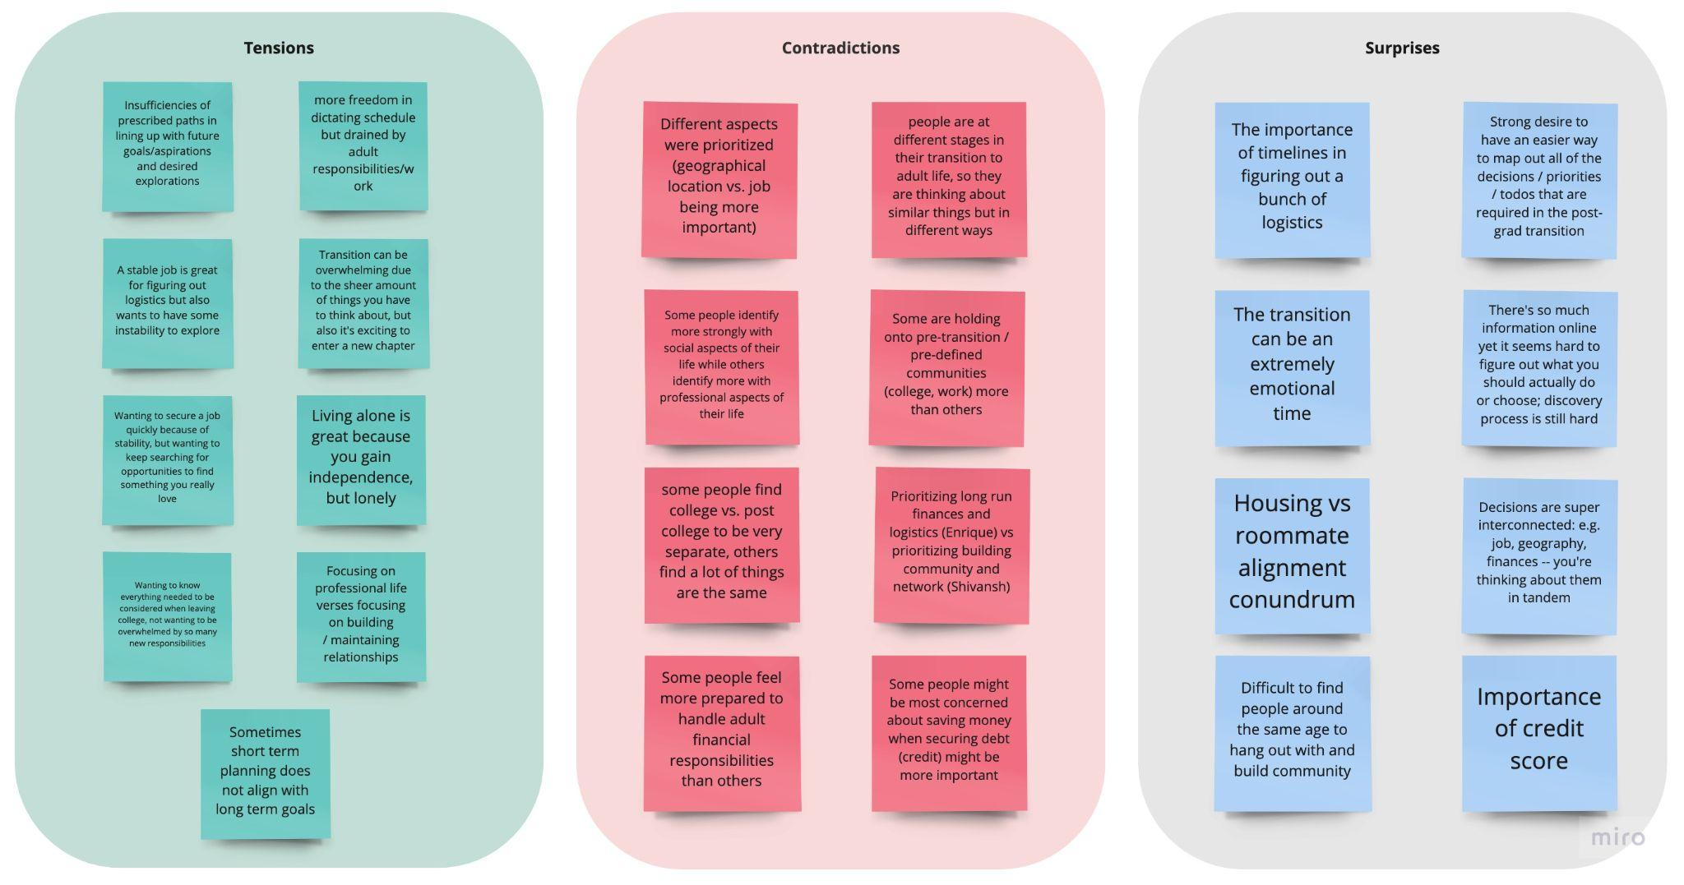
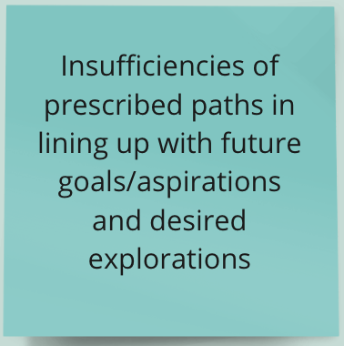
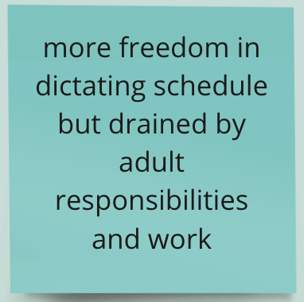
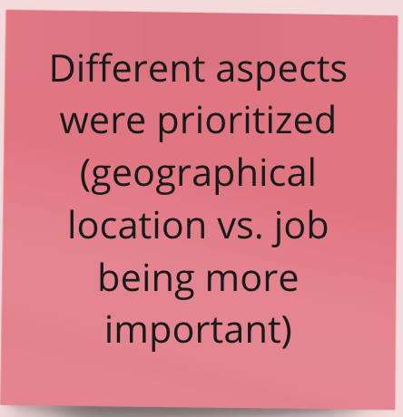
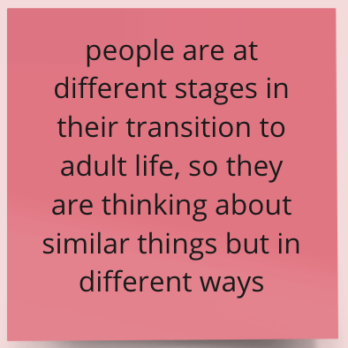
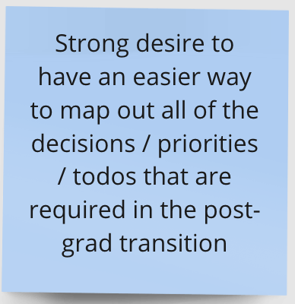
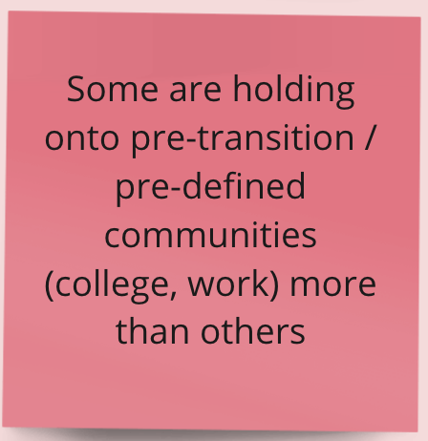
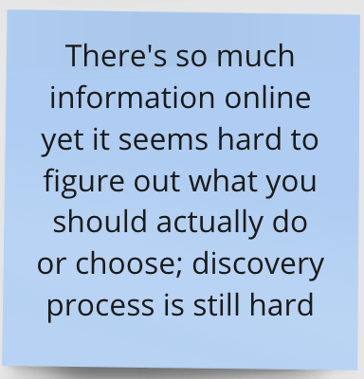
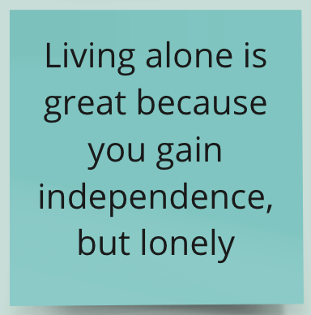
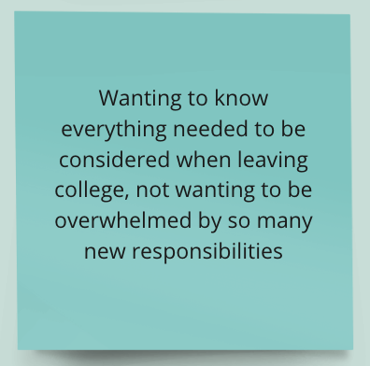
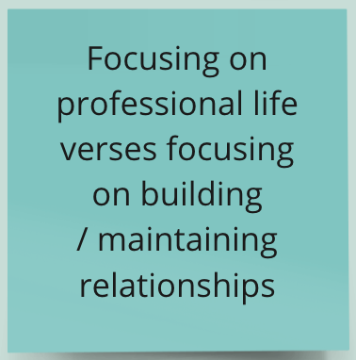
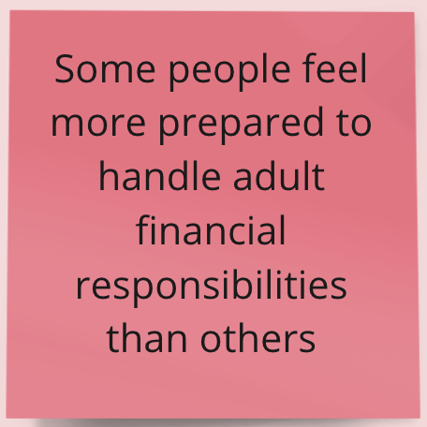
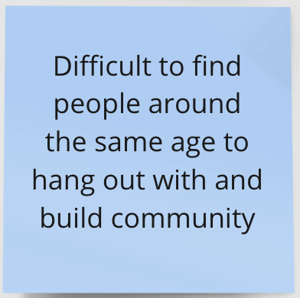
Tensions, Contradictions, & Surprises
Notes:
Tensions:
Big aspirations but frustration at insufficiencies of prescribed post-grad paths
Freedom vs. draining nature of adult responsibilities/work
Living alone is great for independence/exploration but lonely compared to college
Wanting to feel prepared vs. feeling overwhelmed by everything to do
Balancing professional life vs. building/maintaining personal relationships
Contradictions
People prioritize diff aspects of transition (amanda w geography, rachel w emotional/social)
Ppl at diff stages (amanda pre-transition, enrique already graduated) - what ppl think is important at these diff stages is diff
Some holding onto college (rachel), others less so (shivansh excited abt sf)
Some feel more prepared to handle adult financial responsibilities (enrique) than others (amanda)
Surprises
How strong the desire was to have an easier way to map out uncertainties, not set plans
So much info out there but ppl don’t actually use them; discovery of life skills resources still difficult
How difficult ppl found finding community w ppl around the same age post-grad

Slide 19
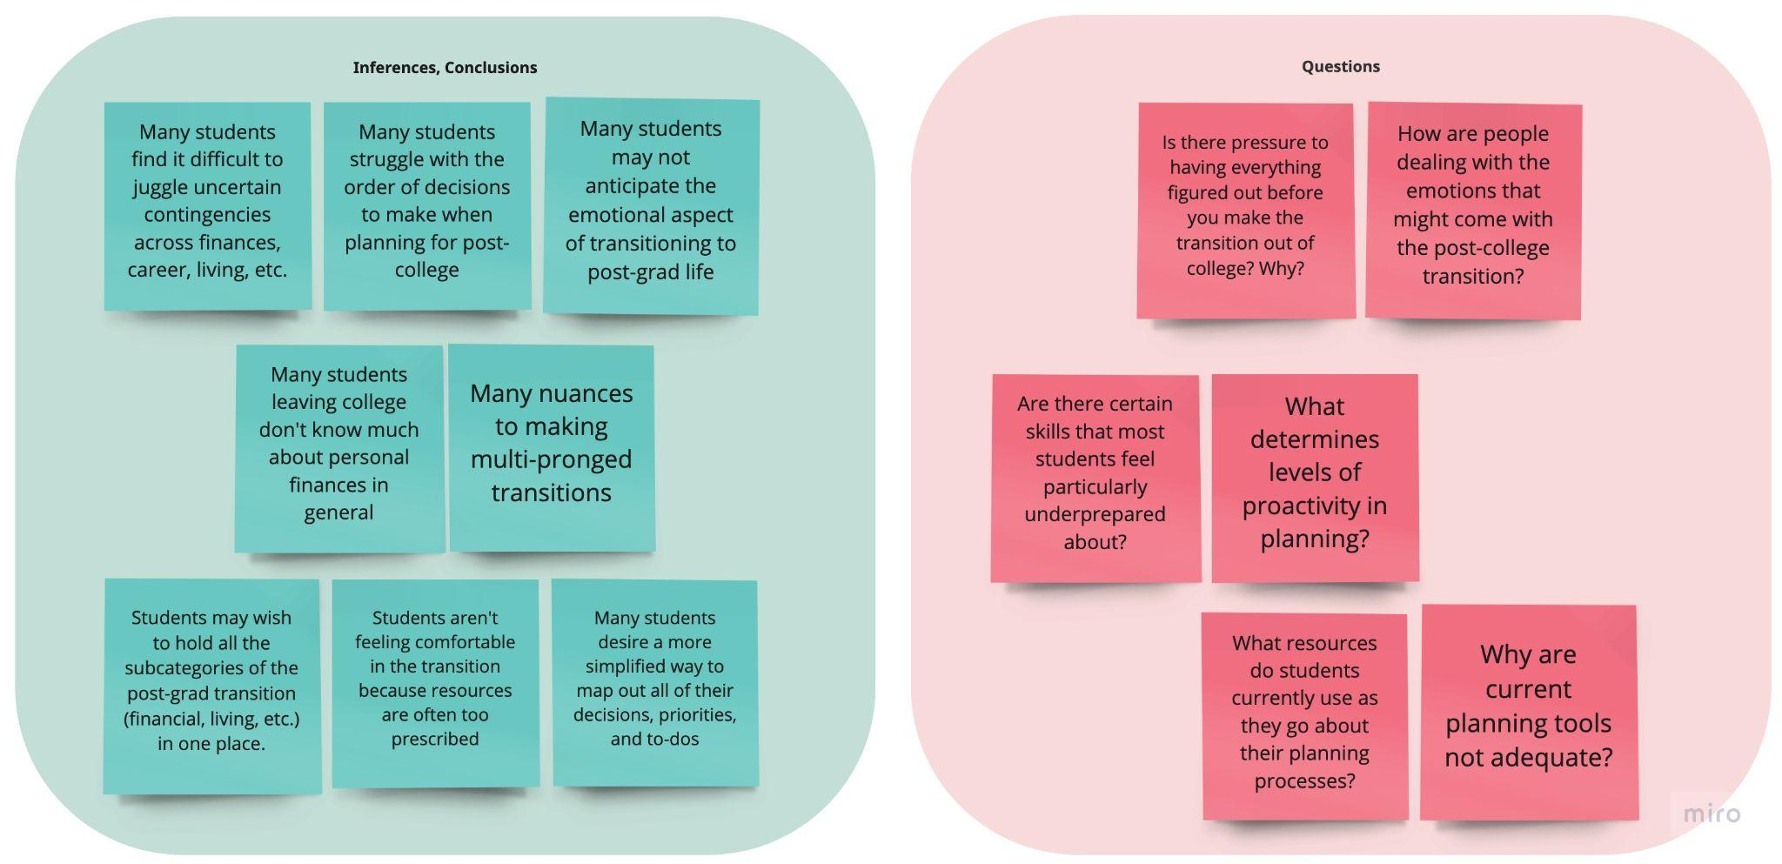
Inferences, Conclusions, & Questions
Notes:
Inferences, conclusions → questions
Difficulty in making decisions, feeling overwhelmed, and not anticipating the emotional aspect of transition → is there pressure to have everything figured out before transitioning and why? How are ppl dealing w the psychological aspects rn?
Many ppl dont know enough about necessary life skills and many nuances to making multi-pronged decisions for transition → Are there certain skills ppl are particularly underprepared for, and what determines level of proactivity in planning?
Students may wish to hold all this info, uncertainty, possible trajectories in one centralized place → what resources do students currently use and why are current tools not adequate?

Slide 20

Initial Insights & Potential Needs
1
2
3
4
Grappling with emotional distress of leaving college
Organizing onslaught of new responsibilities (financial, career, living situation)
Gaining confidence in building a new community
Keeping track of contingency plans and options
Notes:
From these inferences and conclusions…initial insights and needs
College grads transitioning to post-grad need…
Emotional distress leaving college
Deal with onslaught of new responsibilities
Community-building
Keeping track of contingency plans, possibilities, uncertainties

Slide 21
Summary
A
B
C
D
E
…to feel less overwhelmed by impending “adult” responsibilities.
College grads need
…a way to build community in new environments.
…to feel supported in the emotions of leaving college.
…a more concrete knowledge of all the to-dos of post-grad.
…a way to organize plans for different subgroups of transition.
Notes:
Summary of needs:
To feel less overwhelmed by impending adulthood
To build community in new and unfamiliar places
To feel supported emotionally as they leave college and their social/personal life there behind
To feel confident in their knowledge of their to-dos to transition
To organize all the different threads of their transition

Slide 22
Next Steps: Ideate & Prototype
1
3
5
POVs & HMWs
Solutions
Experience Prototype
Create POVs and generate HMWs
2
Brainstorm solutions based on needs
4
Test our assumptions
Interviews
Best Solution
Select and diversify interviewees
Select the best solution
Notes:
Next steps are in ideation and prototyping
Creating povs and generating hmw’s
Interviewing a wider, more diverse group of people to see how well our insights generalize
Brainstorm solutions and select ones to test
Test our experience prototypes and assess our assumptions!

Slide 23
Thanks!
Questions?

